Slide 1
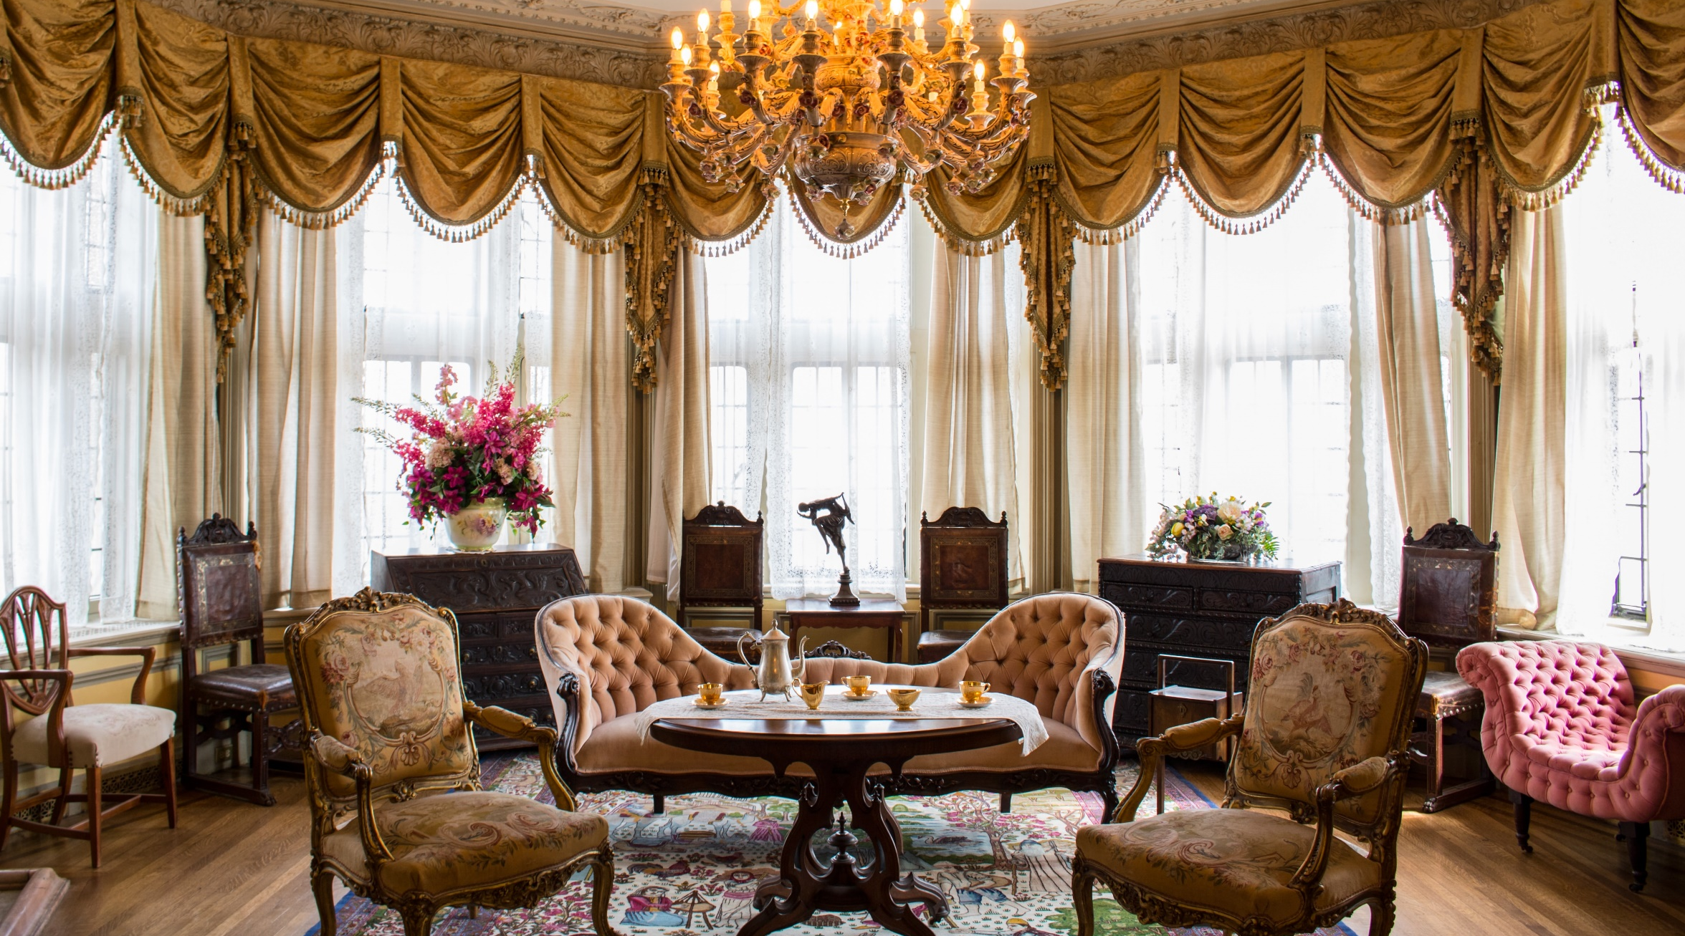
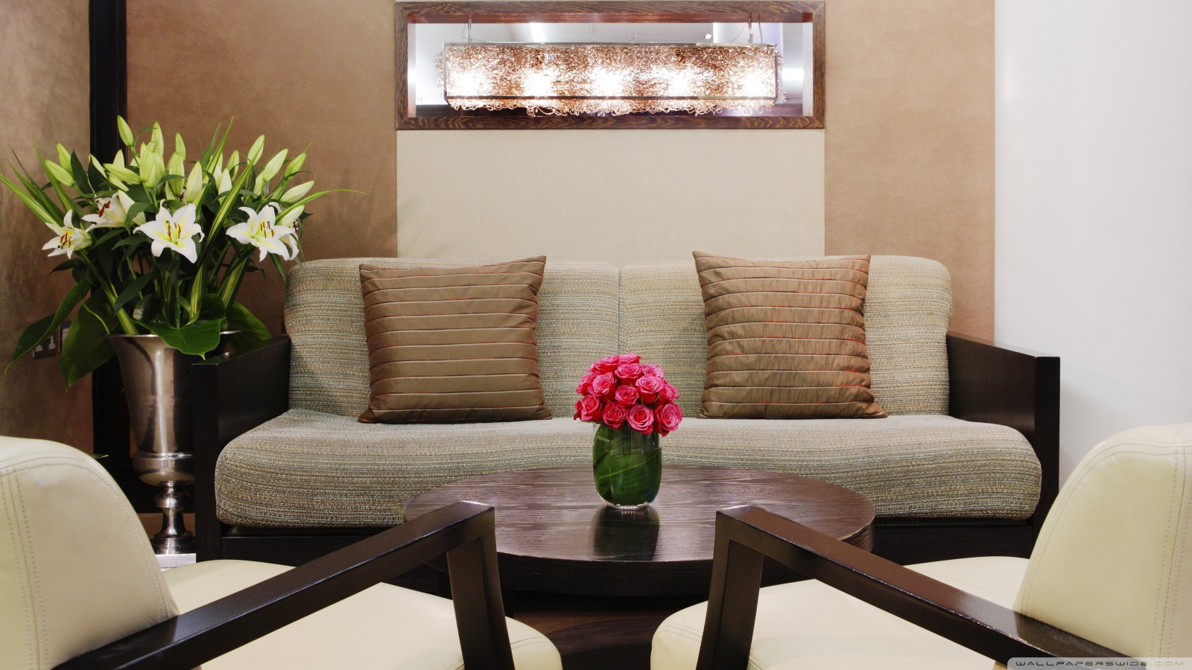
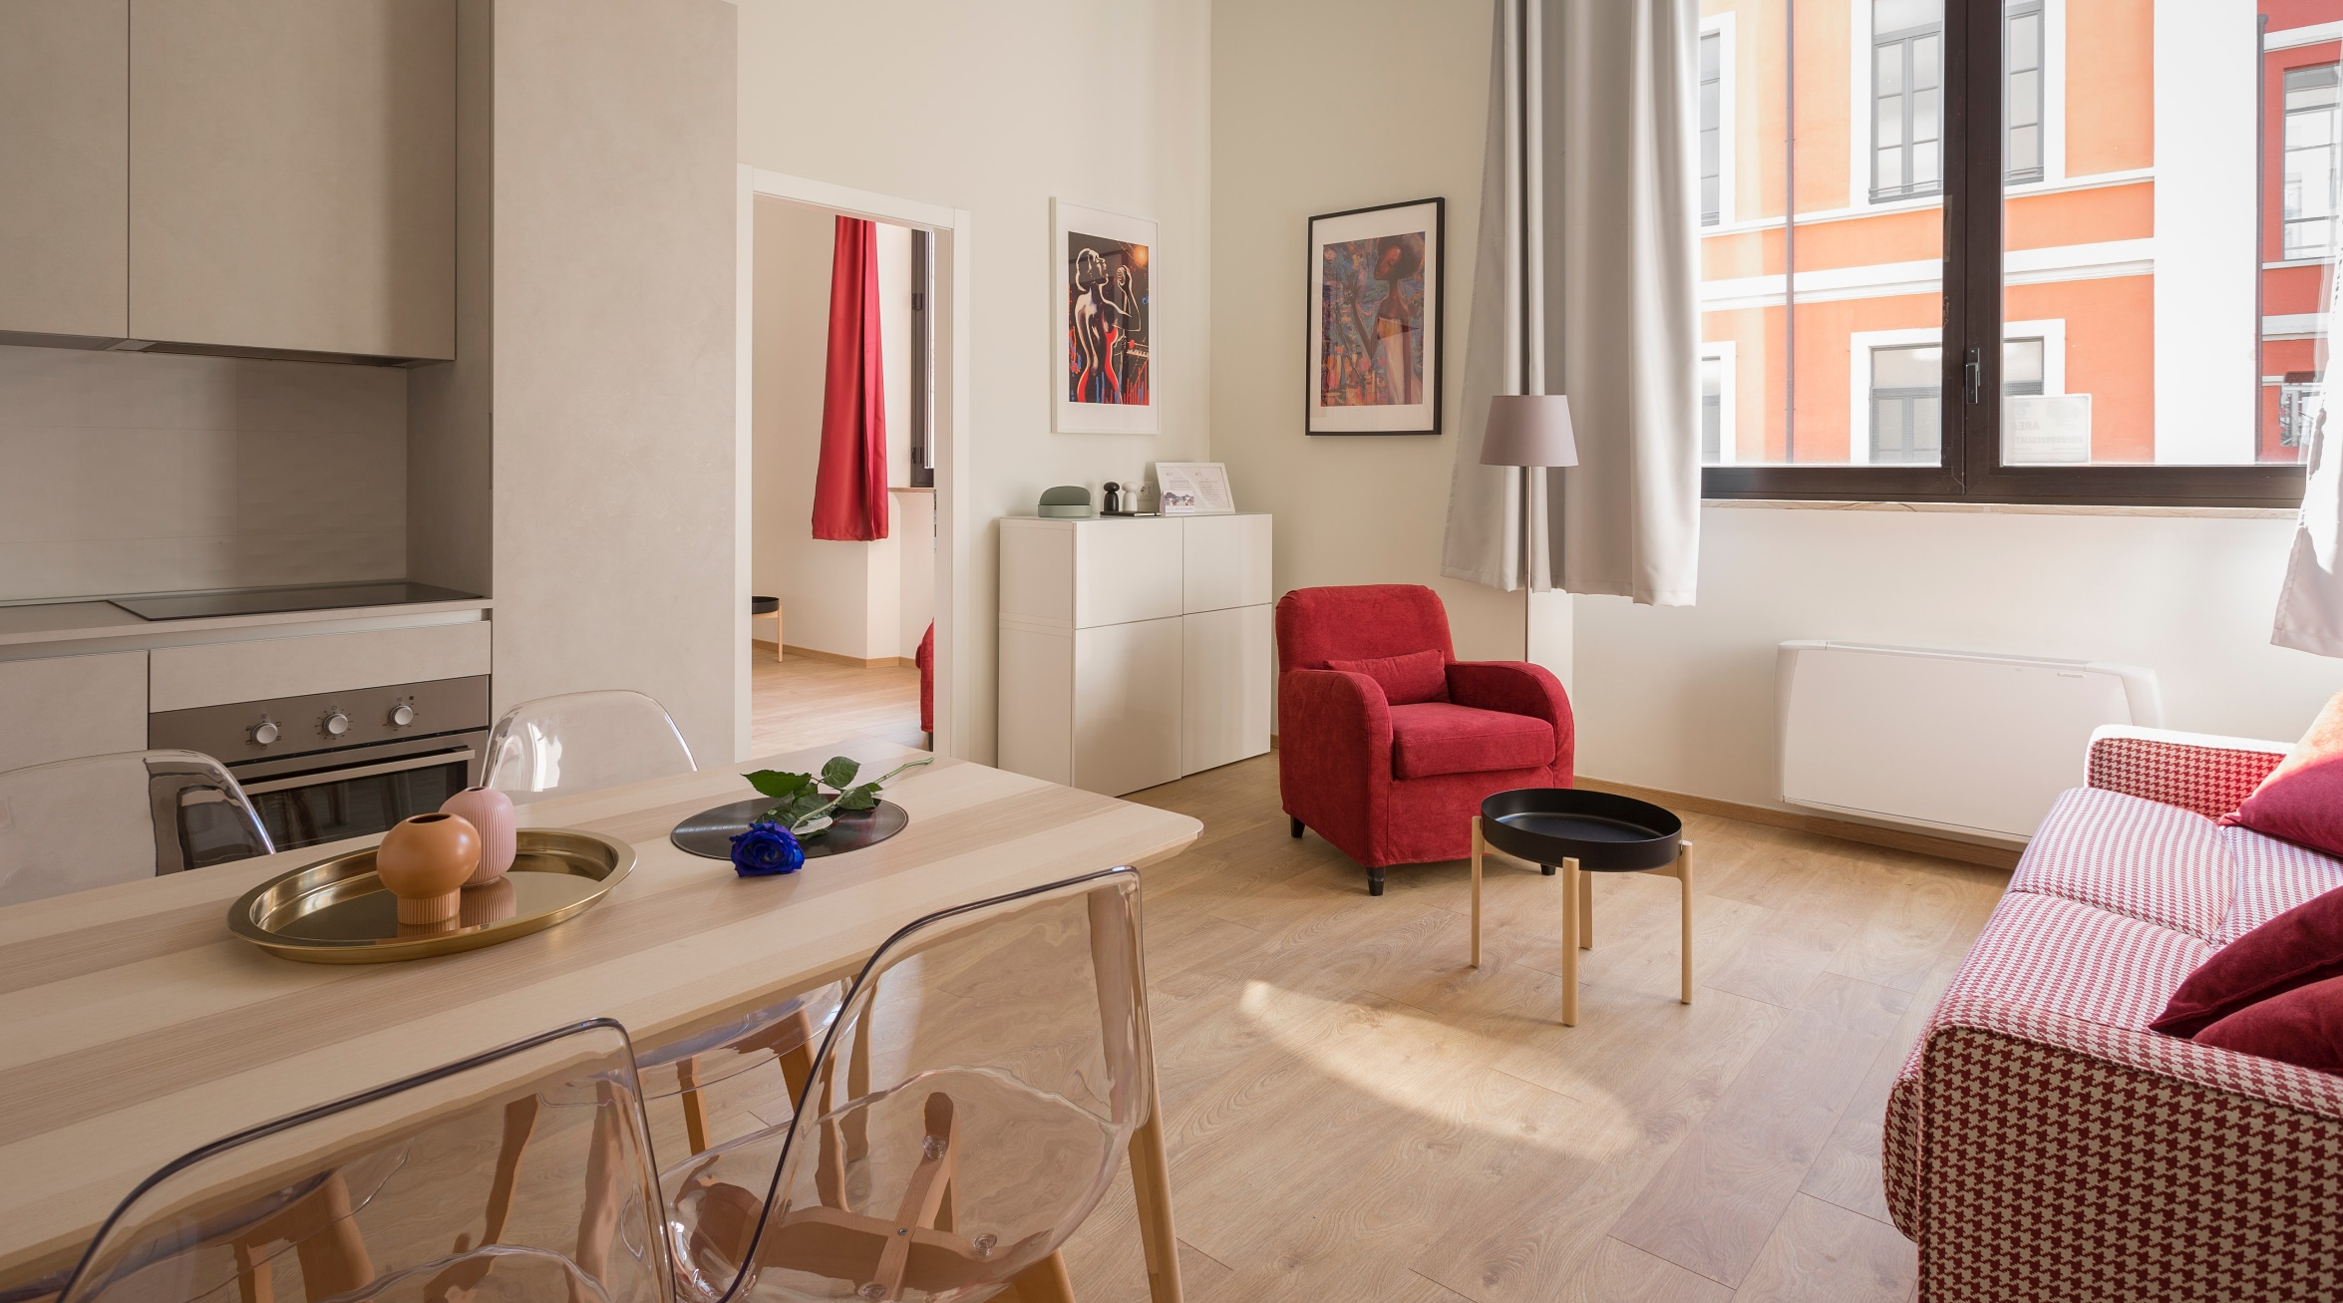

Slide 2

Welcome to our
Kitchen collection

Slide 3
Live kike a King With our
Royal collection

Slide 4
Welcome to our
Modern Furniture
Collection

